Slide 1


IB API Trading System
Michael Kralis

Slide 2
The Basics (EWrapper and EClient)
To create the TradingApp class, inherit the two main classes of the IB API : EWrapper and EClient
EClient is used to send messages and requests to Interactive Brokers
Interactive Brokers sends the data back to the methods inside the EWrapper class
EClient
Interactive Brokers
TradingApp
EWrapper

Slide 3
Requesting Market Data
The insides of the trading system is the ability to stream market data.
After connecting to TWS, a request is made for market data in EClient.reqMktData
Then the data is returned under the function EWrapper.tickPrice
reqMktData
Interactive Brokers
TradingApp
tickPrice

Slide 4
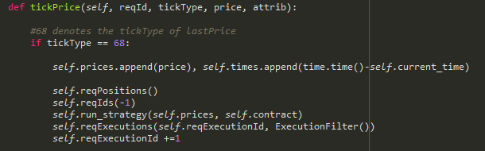
Overriding Functions
EWrapper's methods have return types of void which means they don’t do anything unless they are overridden
For example, the tickPrice function can be overridden to store the data received after reqMktData was called
In this example, 68 stands for “LAST PRICE” so the TradingApp class can continuously add the latest price into an array

Slide 5

GUI Designing: PyQt5
The GUI that is being used in this trading system is PyQt5 which has many great systems and applications
Widgets like QTableWidget, PlotWidget, QLineEdit, QPushButtom were used for the design of the GUI

Slide 6
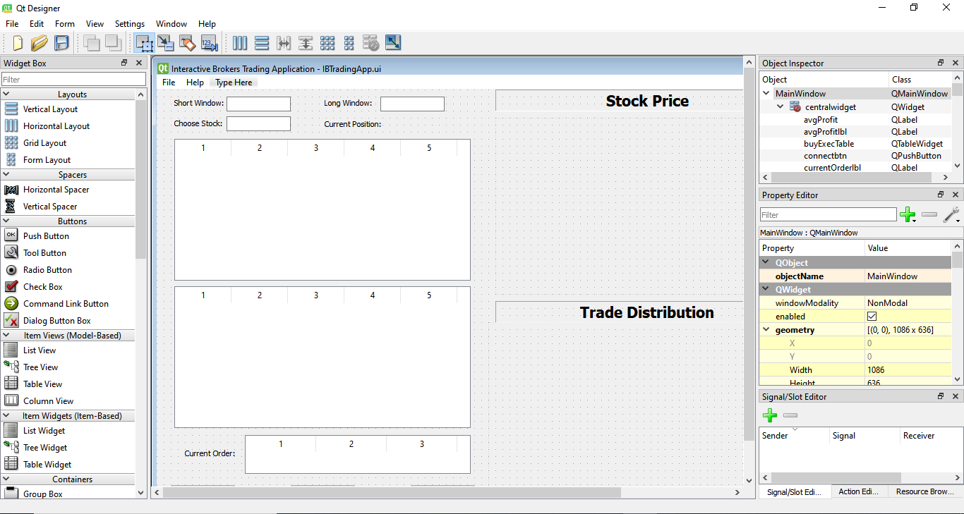
GUI Design: QtDesigner
The basis of the design of the GUI was from QtDesigner
The .ui file is written in XML style language but after going line by line, this method of designing can be exhaustive
QtDesigner allows for an easy quick design

Slide 7
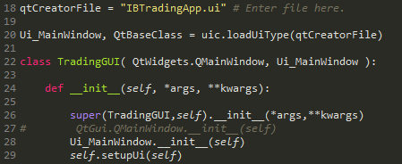

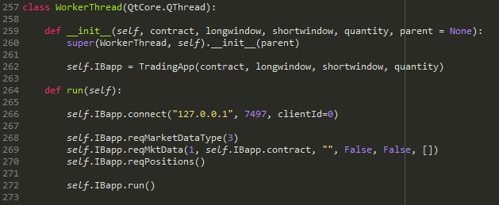
Putting it all together
After overriding the functions in EWrapper and storing whatever data is needed, an object of the TradingApp class can be created within the TradingGUI class
TradingGUI can now make use of the attributes of the TradingApp class to use for plots, tables, stats, etc. and update them in real time using QTimer
CAUTION: Proper threading must be implemented so the GUI does not freeze. QThread to the rescue!

Slide 8
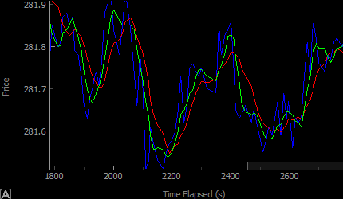
The Strategy
The strategy used in the system is a Moving Average Crossover strategy
This strategy is a fundamental strategy from Technical Analysis which uses a shorter moving average and a longer moving average
Short above Long: Sell
Long above Short: Buy

Slide 9
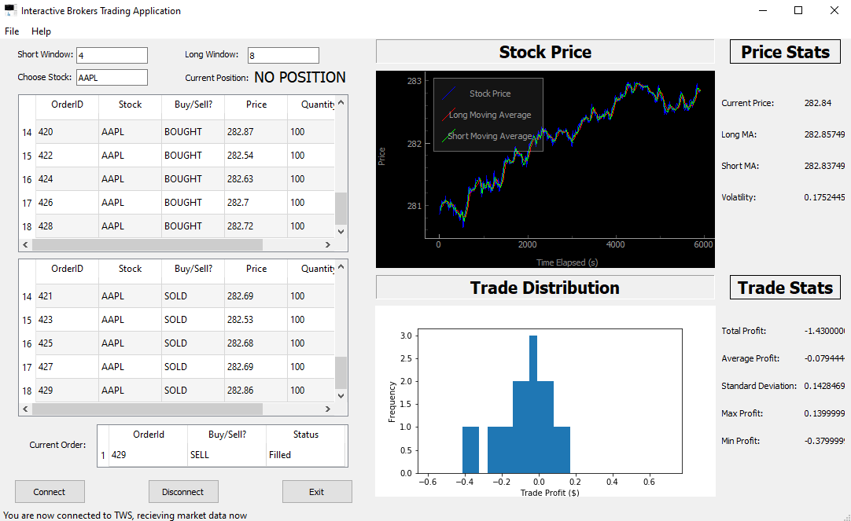
The Final Product
Now let's dig into how it works!

Slide 10
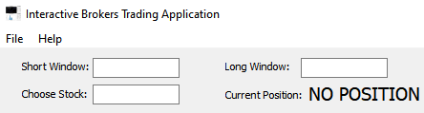

User Inputs
In the top left corner the user can input the short window and long window sizes
The user will also input the stock ticker
After inputting the above information, the user can press connect to initiate a connection to TWS and the strategy will start running
The user can then hit disconnect which will stop the strategy and cancel all open orders

Slide 11
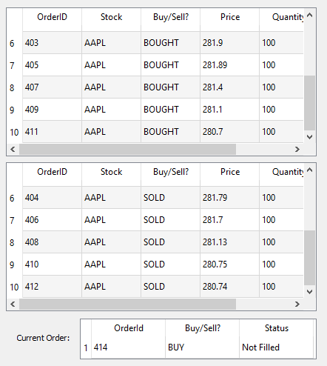
The Trade Log
The trade log holds all the users buys and sells which include details of the orderId, stock, price, and quantity
The trade log also holds the information of the most recent order and its current status

Slide 12
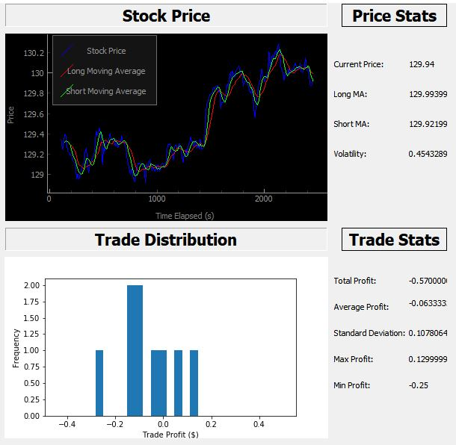
Graphs and Stats
The Stock Price graph shows a real time update of the stock price, long window moving average, and the short window moving average
The Price Stats show the current stock price, current long MA, and current short MA as well as an annualized volatility measure
The Trade Distribution histogram gives the user insight on how the strategy is doing in real time
The Trade Stats gives the basic statistics of how the strategy is preforming for the day

Slide 13
That’s all folks!
See, I told you algorithmic trading isn’t so scary!
While this system is programmed to do a Moving Average Crossover strategy, another system can be programmed to do many other strategies
Moving forward, this system will be updated and refined to include more strategies and features

